Slide 1


DESIGN 1
Lesson 1: Adding Images: The <img> Tag
Ms. Abboud • Grade 9 - Design 1 • Term 1, Week 6

Slide 2
Learning Objectives
WALT - We Are Learning To
WILF - What I'm Looking For
Insert images into a webpage correctly using the <img> tag.
Use src and alt attributes on every image.
I can add an image using the correct src path.
I can write meaningful alt text for an image.

Slide 3
Academic Vocabulary
Image Tag (img)
Source (src)
The self-closing <img> tag used to embed a picture in a webpage.
The attribute on an <img> tag that tells the browser where to find the image file.
Alt Text
The alt attribute's description of an image, used by screen readers and shown if the image fails to load.

Slide 4
Frayer Model: Alt Text
DEFINITION
CHARACTERISTICS
The alt attribute's description of an image, used by screen readers and shown if the image fails to load.
An attribute on <img>; describes the image in words; read by screen readers.
ALT TEXT
EXAMPLES
NON-EXAMPLES
alt="A photo of me smiling outdoors".
The raw filename left as the description, e.g. "IMG_2024.jpg".

Slide 5
National Identity Integration
UAE Landmarks and Tourism: a well-chosen photo of a UAE landmark communicates instantly what pages of text would take much longer to say. Alt text makes sure that message reaches everyone.

Slide 6
STARTER
Text Alone vs. Text + Image
Compare a plain-text page to the same page with a relevant image.
What does the image add that text alone doesn't?
Hook • Engage & Ask
5 - 10 minutes

Slide 7
LESSON CORE
I Do: The <img> Tag
<img> is self-closing - there's no </img>. It always needs src (where the file is).
alt describes the image for screen readers, and shows if the image fails to load.
Gradual Release of Responsibility
30 - 40 minutes
Example: a local image with alt text
<img src="images/profile.jpg" alt="A photo of me smiling outdoors">
1 / 3

Slide 8
LESSON CORE
We Do: File Organization
Demo: add an image from the project folder, and one linked from a web address.
Discuss: why images should live in a dedicated images/ folder.
Gradual Release of Responsibility
30 - 40 minutes
2 / 3

Slide 9
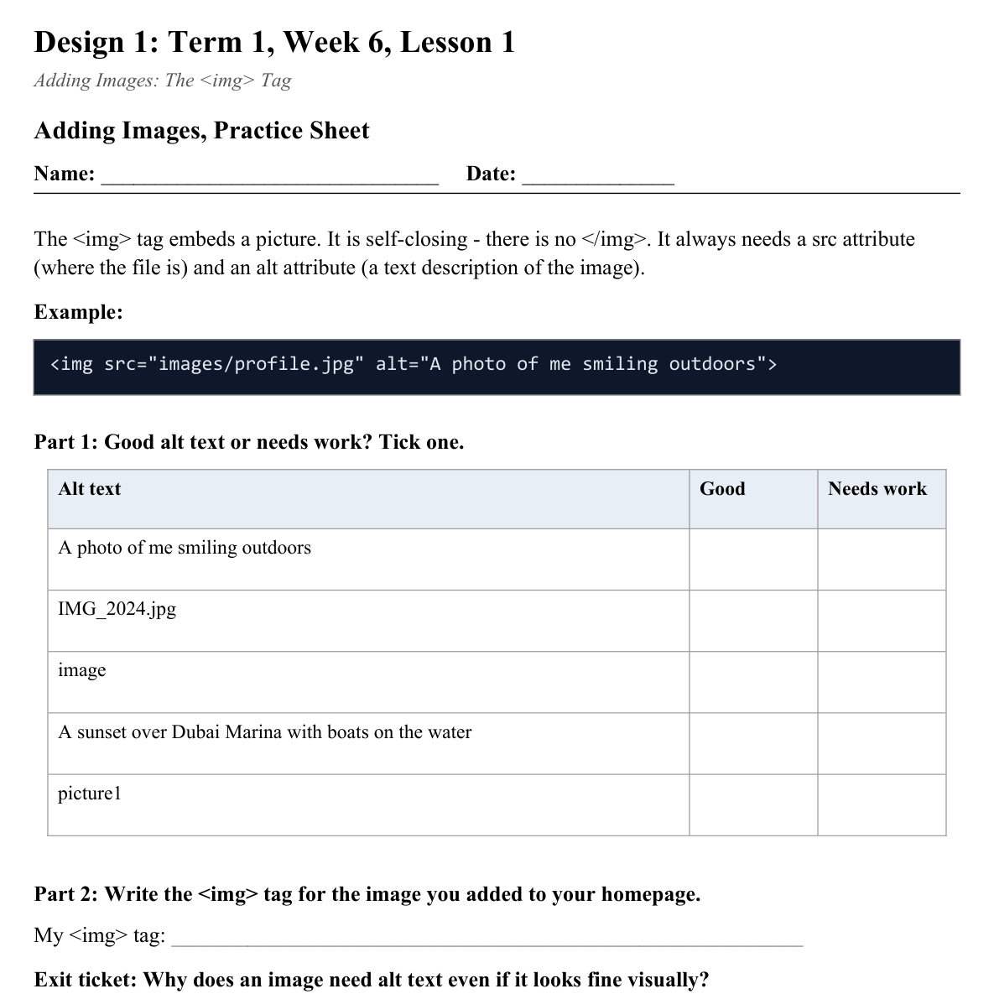
LESSON CORE
You Do: Add Your First Image
Create an images/ folder, add one image, and insert it with a meaningful alt description.
Activity: Adding Images, Practice Sheet
Gradual Release of Responsibility
30 - 40 minutes
3 / 3

Slide 10
CLOSURE
Exit Ticket
Why does an image need an alt attribute even if it looks fine visually?
Transition & Extend
5 - 10 minutes

